Slide 1
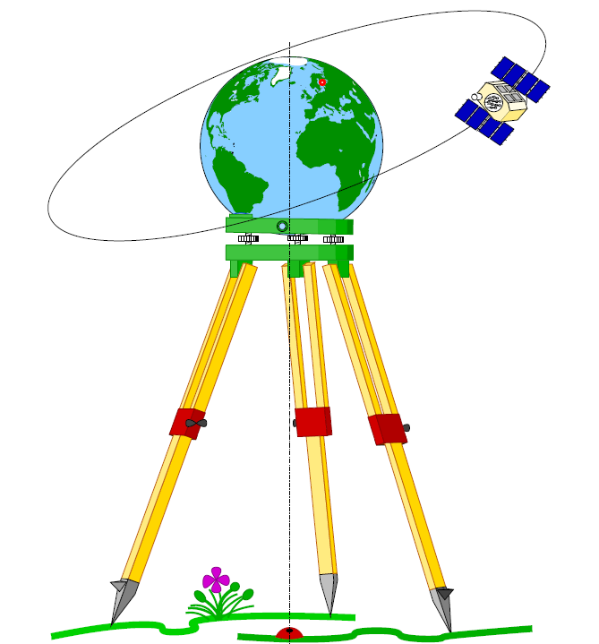
Geodesy

Slide 2
Curvature and Refraction
it is necessary to consider the effect of curvature and refraction on a
line of sight.
In geodetic work, curvature is understood to mean the apparent
reduction of elevation of an observed station, due to the rotundity of
the earth and consequent falling away of a level line from a horizontal
line of sight.
Refraction is understood to mean the apparent increase of elevation of
an observed station, due to the refraction of light and consequent
curving of t he l ine of sight as it passes through air of differing
densities.

Slide 3
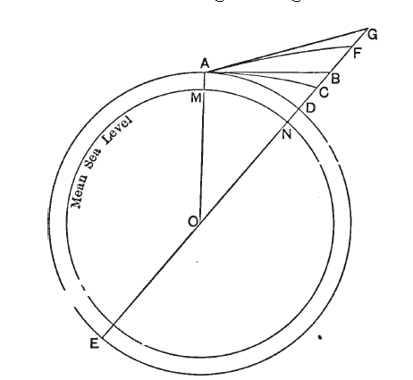

Slide 4
The net result is an apparent loss of elevation, causing an angle of depression
in, sighting between two stations of equal altitude .
In Figure, the circle ADE represents a level line through the observing point A,
necessarily following the curvature of the earth.
Assuming the line of sight to be truly level or horizontal at the point A, the
observer apparently sees, in the straight line direction AB (tangent to the circle
at A) , but owing to the refraction of light actually looks along the curved line
AC (also tangent at A) . The observer therefore, regards C as having whereas
the point D is the one which really has the same elevation as A. There i s hence
an apparent loss of elevation at C equal to CD, as the net result of t he loss BD
due to curvature and the gain BC due to refraction. Just as C appears to lie at B,
so any point F appears t o lie at a corresponding point C. The apparent difference of elevation of the points A and F i s measured by t he line BC,
the true difference being DE. As DE BC BD FG, the apparent loss equals BD FG,
which does not ordinarily differ much from CD.

Slide 5
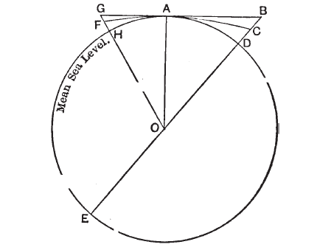
Referring to Figure, BD represents t he effect of curvature, and BC the effect of refraction, as in the previous figure . By geometry we have,

Slide 6
The earth is so large as compared with any actual case in practice that we
may substitute AD ( = distance, called K) for AB and DE (= 2R) for BE, without any practical error, and write
in which all values are to be taken in the same units. As the result of proper investigations we may also write
in which m is a coefficient having a mean value of .070, and K and R are the same as before. We thus have

Slide 7
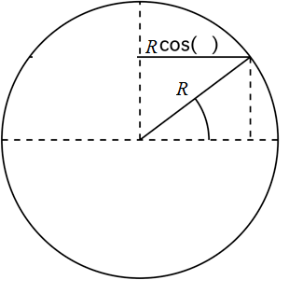
CALCULATIONS USING SMALL CIRCLES (PARALLELS OF LATITUDE)
When calculating arc lengths on small
circles (parallels of latitude) the radius of
the circle is less than the earth’s radius
(except for the equator).
Therefore, before we start the arc length
calculation, we need to find the radius of
the parallel of latitude. The formula is:
𝑟 = 6400 cos (ϕ)
where ϕ is the angular measurement of
latitude.
Arc length = r cos ϕ . dλ

Slide 8
MERIDIAN CONVERGENCE
A basic but important geometric relationship is:
arc (linear units) = central angle (radians) x circular radius (linear units)
Applying the above equality to triangle EAC in Fig. (a) and also using Fig. (b), then:
arc AC = dt NA cot ϕA --------- (1)
Similarly, from triangle FAC we have:
arc AC = dλ NA cos ϕA ----------------- (2)
Because the arcs in (1) and (2) are approximately equal, it immediately follows:
dt = dλ sin ϕA ---------------- (3)
For the differential planar case, an element of geodesic ds is equal to an
element of normal section and is a straight line Fig. ©. From triangle ABC, we obtain:
arc AC = ds sin αAB ------------- (4)
Equating (4) and (2), an expression for dλ is found
dλ = ds sin αAB /(NA cos ϕA) ----------------- (5)

Slide 9
Finally, substituting (5) into (3) provides the formula to compute the convergence of
meridians dt as a function of the geodetic latitude ϕA of point A, the differential
distance ds between the two points, and the azimuth αAB from point A to point B,
Namely
dt = ds sin αAB tan ϕA/NA ------------------ 6
The symbol NA refers to the principal radius of curvature of the prime vertical of
point A, computed as follows: NA = α/W with W = (1 - e² sin²ϕA)^{3/2}, where the
square of the ellipsoid eccentricity is given in closed form by e² = 2f - f ². The ellipsoid
of revolution adopted in this investigation is the GRS80 ellipsoid ; its two geometric
parameters of interest are size, defined by the semimajor axis a = 6,378,137 m, and shape, specified by the flattening f or, equivalently, its inverse,
f = 1/298.257222101.
αdc = αcd ± 180 ͦ+ dt

Slide 10
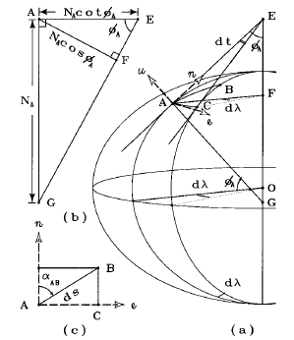

Slide 11
If the two points lying on different latitudes ϕ1 and ϕ2 , the
meridian convergence dt given by the following formulae:
dt" = Δλ sin φm sec Δφ/2 + Δλ² . F
Where φm is the average latitude of A and B
Δφ is the different the average latitude of A and B
F = sin φm cos²φm sin²1"

Slide 12
Reduction to Mean Sea Level
In geodetic work, all horizontal distance s are referred to mean sea level, that
is, the stations are all supposed to be projected radially (more strictly,
normally) on t o a mean-sea- level surface, and all distances are reckoned on this surface .
All the angle s of a triangulation system are measured as horizontal angles, and
are not practically affected by the different elevations which the various
stations may have .
If the lines which are actually measured (bases and check bases) are reduced
to mean sea level, all computed lines will correspond to this level without
further reduction.
It is necessary, therefore, to connect the ends of base lines with the nearest
bench marks whose elevations are known with reference to mean sea level .

Slide 13
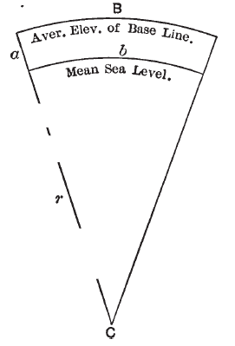

Slide 14
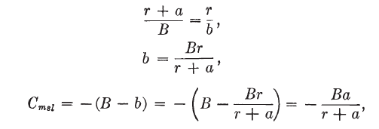
then, from Figure
or since a i s always very small as compared with r, we may write
=

